Slide 1
Business Problem
The hotel management wants to understand the financial impact of channels (Online Travel Agencies (OTAs), direct bookings, and travel agents) to optimize their strategy and improve profitability.
Analysis conducted by : Sara Gamil
Using Excel ( Excel functions , Pivot Table , Pivot Charts )

Slide 2
Business Questions
What is total revenue,profit , booking volume and commeession amount
What is the highest channel in terms of commession persentage
what isthe impact of commeession on revenue for each channel
What is booking volume for each channel
What is booking volume per month

Slide 3
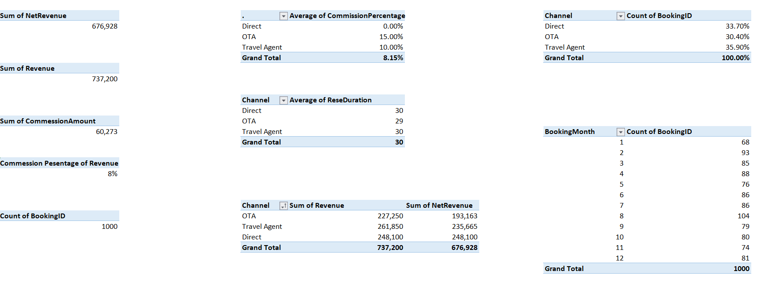

Slide 4
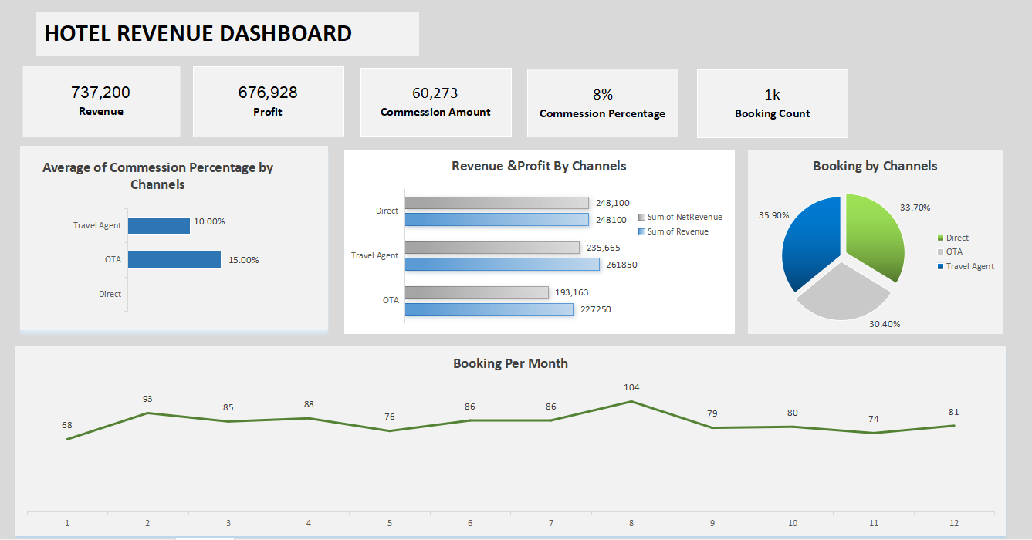

Slide 5
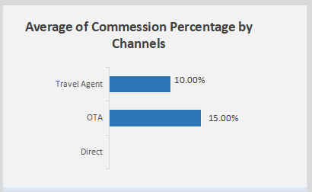
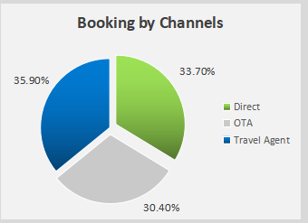
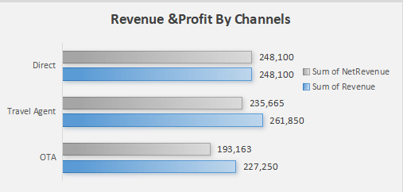
OTA channel is the highest channel in terms of commession persentage and it is a lower channel make revenue and booking .
Recommendation :
- We need study marketing cost if this cost is less than commession persentage and same or more booking rate of OTA , will cancel OTA and use direct reservation
- Use Customer Referral Marketing , which is the quality of service or offers that we provided to the guests that will make guests recommend the hotel for their friends

Slide 6
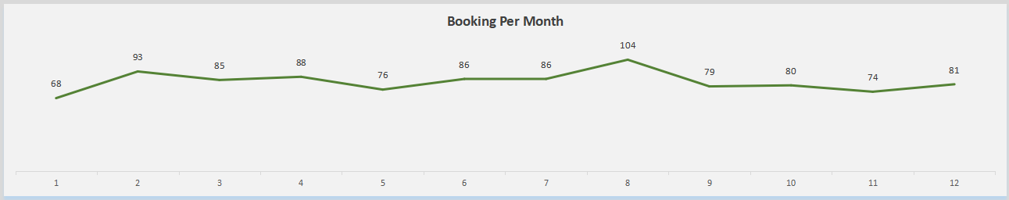
Booking volume per month over the year
February and Ogust months are the highest months in terms of booking volume
Recommendation :
increasing marketing and offers in these months

